Slide 1

The Petri net tool GreatSPN and recent advancement in DD variable ordering
Elvio G. Amparore and Susanna Donatelli
Università degli Studi di Torino, Italy
UNIVERSITÀ
DEGLI STUDI
DI TORINO

Slide 2
Two main topics
How to take a tool suitable for research and make it effective for teaching
How to take a tool that is now suitable for teaching and making it to compete in the model-checking context

Slide 3
Two main topics
How to take a tool suitable for research and make it effective for teaching
How to take a tool that is now suitable for teaching and making it to compete in the model-checking context

Slide 4
Two main topics
How to take a tool suitable for research and make it effective for teaching
How to take a tool that is now presumably suitable for teaching and making it to compete in the model-checking context
Variable orders and p-(semi)_flows

Slide 5
Two main topics
How to take a tool suitable for research and make it effective for teaching
How to take a tool that is now presumably suitable for teaching and making it to compete in the model-checking context
Joint work with Amparore, Ciardo, Miner.

Slide 6
Petri nets
Bipartite directed graph with:
P = set of places (system state)
T = set of transitions (system evolution)
I⁺ ⊆ T×P = input arcs
I⁻ ⊆ P×T = output arcs
m₀ = initial marking
State space analysis: enumerate all the markings reachable from m₀.
C = I⁺ + I⁻ is the incidence matrix.
Any vector x s.t. x ∙ C = 0 is called a P-semiflow.

Slide 7
Variable Orderings of DD for Petri nets
Petri net model m
Variable Ordering l
(assigns places to levels)
Decision Diagram
of the state space of m
using the ordering l
The variable ordering l is a linear mapping between the state variables (the places) and the DD levels.

Slide 8
Variable Orderings of DD for Petri nets
Petri net model m
Variable Ordering l
(assigns places to levels)
Decision Diagram
of the state space of m
using the ordering l
The variable ordering l is a linear mapping between the state variables (the places) and the DD levels.
The variable ordering considerably affects the size of the Decision Diagram.

Slide 9
A few things we know
Optimal ordering is NP-complete [1]
Tools use static and/or dynamic ordering
Dynamic works better if it starts from a good static
Many heuristics exists for static ordering
How to choose among the orders produced? ==> Metric M:
How to evaluate metrics heuristics?
==> Coefficient of correlation
[1] Bollig, B., Wegener, I.: Improving the variable ordering of OBDDs is NP-complete. IEEE Trans. Comp. 45(9), 993{1002 (Sep 1996)
[2] Elvio Gilberto Amparore, Susanna Donatelli, Marco Beccuti, Giulio Garbi, Andrew S. Miner: Decision Diagrams for Petri Nets: A Comparison of Variable Ordering Algorithms. T. Petri Nets and Other Models of Concurrency 13: 73-92 (2018)
[3] Amparore, Ciardo, Donatelli, Variable order metrics for decision diagrams in system verification, submitted for pubblication

Slide 10
Current approach in GreatSPN
Use various heuristics to produce different orders
simulated annealing on a metric and/or Force
Evaluate according to metrics
Use a metric-based meta-heuristic to decide which order(s) to use
Heavily rely on P-semiflows or on nested units (for nuPN)

Slide 11
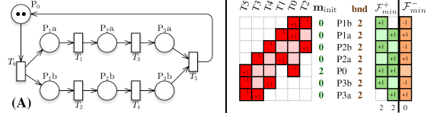
Metrics:
Based on the incidence matrix: PTS, Noack, Tov, Sum of Spans (SOS), Sum of Tops (SOT), Soups (impact of transitions on the Decision diagram), Bandwith reduction
Based on (minimal set of generators) of P-semiflows: impact of places that have correlated markings
PSF (sum of light and dark greens
SOT, SOS, SOUPS

Slide 12
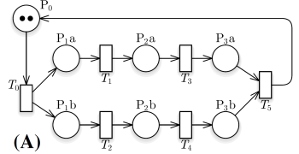
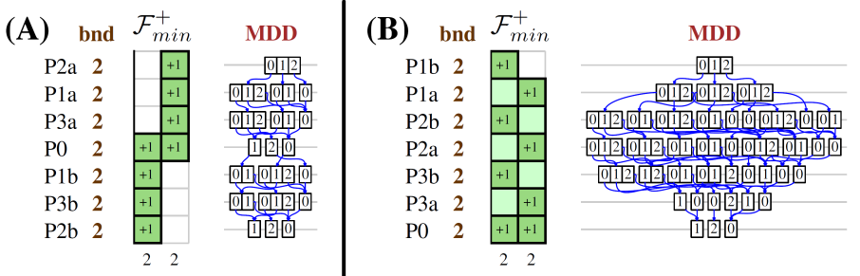
Application of PSF
PSF(A) = 8
PSF(B) = 13

Slide 13
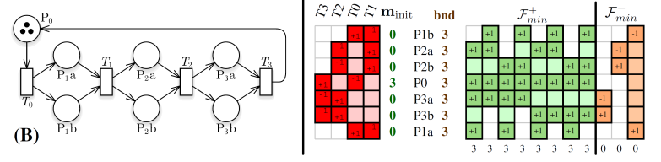
PSF: not a solution
PSF correlates badly with nets of this shape (exp. number of invariants)
Consider also non-positive p-flows
Should consider a basis or a minimal set of generators?

Slide 14
P-flows:
What do we know of P-flows?
Build F_{min} as the set of minimal (g.c.d =1 and no inclusion of support) p-flows
Set F_{min} is unique and it is a generator set for the whole set F
Use it to define PF, the metric that considers the constraints posed by p-flows

Slide 15
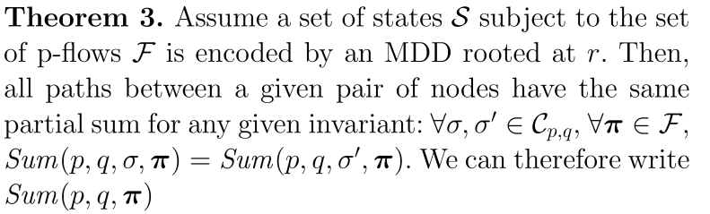
P-flows and DD [1]:
Levels in a DD that ``closes’’ a p-semiflow (or a generic invariant) are singletons (each node one value)
The partial sum at level k of the DD of a p-flow is the same for all nodes at level k
[1] iRank: a variable order metric for DEDS subject to linear invariants
E. G. Amparore, G. Ciardo, S. Donatelli, and A. Miner

Slide 16
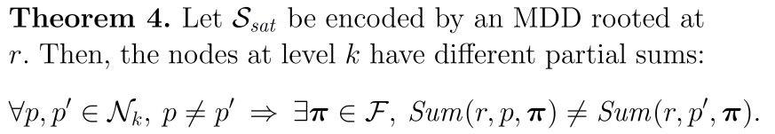
P-flows and DD:
Stronger if the DD encodes S_{sat} (the set of states that satisfy a set of invariants): nodes at level k have different partial sums of the invariants

Slide 17

Metrics:
Measure of dependency: the number of ``open p-flow’’ at level k
Sum over all places of the number of greens and orange (dark and light) that involve that place
PF

Slide 18
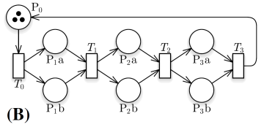
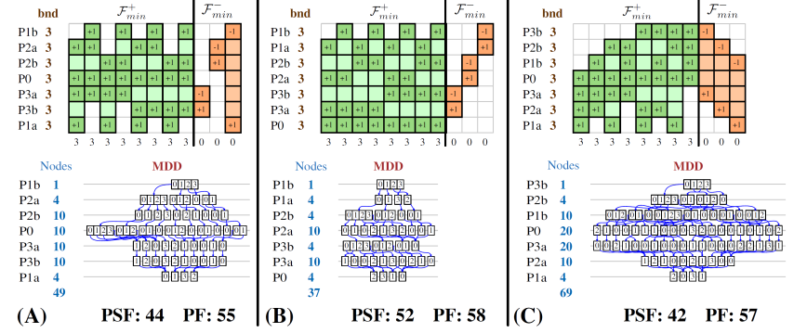
Is this the solution?
Not quite so!

Slide 19
After thought on PSF and PF
the number of nodes at level k is influenced by the number of distinct information we need to keep
by counting the number of ``open p-flows’’ at level k we are counting a lot of redundant info at level k
Looking for the set of independent p-flows at level k
==> iRank
expected: linear increase in iRank – exponential increase in MDD size

Slide 20


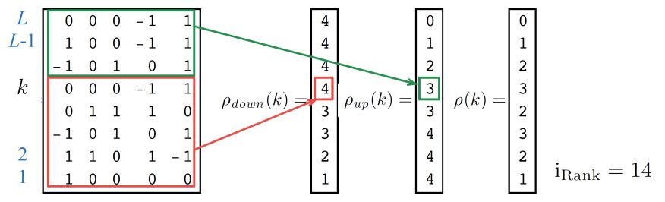
The i-Rank metric
Matrix F of flows (order of rows important, colums irrelevant)
Estimate the number of independent flows at level k
where:
Number of open inde-pendent p-flows above k
Number of independent p-flows already closed at k

Slide 21
iRank evaluation
Evaluation on 40 different models from MCC2017
Solved with GreatSPN using the Meddly library
Followed the evaluation procedure in [1] based on the Spearman coefficient of correlation among metric value and final DD size ( [0.8, 1]: very strong, [0:6; 0:8] strong, 0:4; 0:6] moderate)
ICC: correlation on the set of orders V_{impr}
BCC: correlation on the set of orders V_{best}
[1] Amparore, Ciardo, Donatelli, Variable order metrics for decision diagrams in system verification, submitted for pubblication

Slide 22
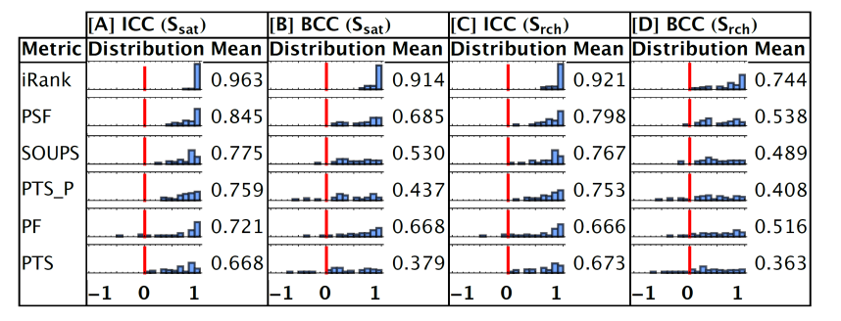
iRank evaluation
V_{impr} and V_{best} built from 1,000 initial random orders by generating sequences of increasingly better orders (in terms of MDD final size) until a convergence criterion is satised;
V_{impr} retains all orders -- mixture of good and bad orders
V_{best} retains only the last orders in each sequence (1,000 orders)
red bar height: 15

Slide 23
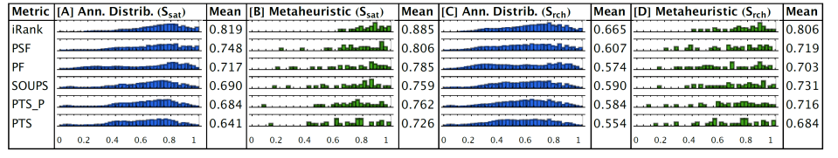
i-Rank evaluation
Metrics can be used as an objective function inside a simulated annealing procedure? 1000 runs per model, from different random orders -- (mean and distributions of the 40.000 orders scores)
Metrics can be used as a a meta-heuristic to select one among the orders produced by the simulated annealing? (one order per model – 40 orders scores)

Slide 24
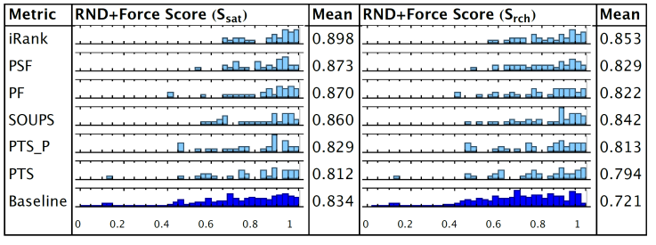
Evaluation on orders produced via Force
For each model, apply Force to 1000 initial orders
Baseline: 40 x 1000 points computed using Force
Metric row: score for 40 MDD sizes, one per model, selected using the metric of the row.

Slide 25
Conclusion and future work
Variable order metrics heuristics and metrics to produce meta-heuristic are a central topic for an effective use of decision diagrams
Good if we have invariants. Better if states satisfying invariants are in large part reachable
If a significant part of the places is not part of any invariants? We are working in inequalities (what Chiola called D-invariants, some 30 years ago and linea algebra will call slack variables)
Can i-rank work on the sat-set of a set of constraints?

Slide 26
Two main topics
How to take a tool suitable for research and make it effective for teaching
How to take a tool that is now suitable for teaching and making it to compete in the model-checking context

Slide 27
GreatSPN: a tool for teaching (?)
Objective: make it effective for teaching
Balance between:
Richness of formalisms and analysis techniques
Steepness of the learning curve
Driving concern: the tool should support the learning objectives

Slide 28
Typical Petri nets tools are
Often inherently ``multi-formalism’’
P/T and Stochastic PN
P/T and colored PN (stochastic and not)
Stochastic and timed
and many more… (algebraic, recursive, OO, …)
Mostly from research groups
A lot of interesting features
Designed at different points in time (even decades of difference)
Lot of ``untold’’ characteristics (not really for newcomers to Petri nets)
And GreatSPN has a sum of all the problems + a lot of grey hairs….

Slide 29
Tools for Petri nets and teaching
Either very simple (only token game, possibly reachability set/graph) – gentle learning curve
Or effort inside a larger tool – steep learning curve
CPNtools has automatic correction of exercise and a whole chapter about teaching CPN in the CPN book

Slide 30
Motivations
Teaching experience of more than 10 years in a system verification course
We teach process algebras, Petri nets and timed automata, various analysis techniques including LTL and CTL model-checking, with tools like NuSMV, GreatSPN and Uppaal.
but… students loved timed automata (they actually loved Uppaal) and did not like Petri nets, not to mention WN (they actually didn’t like GreatSPN)

Slide 31
Motivation
Build a new GUI and solve the problem (@PNSE 2015)
It wasn’t quite enough: students liked GreatSPN more than Uppaal, but
the ``time to market’’ of the first exercises was still too long
most of the time in lab classes was spent on the tool and not on the exercise (too many options and too many features!)
Manual and video tutorial did not help
limitation of scope
"Formal methods are best taught by examples’’ – see citation [8] in our ICATPN2018 paper.
learning by examples

Slide 32
Motivation
A shift of paradigm in my course (and not only): from simple examples back to theory, and from theory back to examples in an iterative manner.
Start with examples, with hand-on.
Need an easy-to-use graphical support, with, e.g.
token game
RG visualization
Decision diagram visualization

Slide 33
Motivation
But these features are often already there, what is the point?
how accessible are they?
token game (need to draw the net, what about net classes?)
RG visualization (how many RG techniques are there?)
Decision diagram visualization (for the state space of any net?)

Slide 34
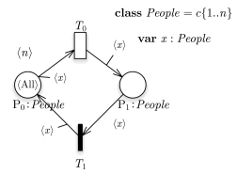
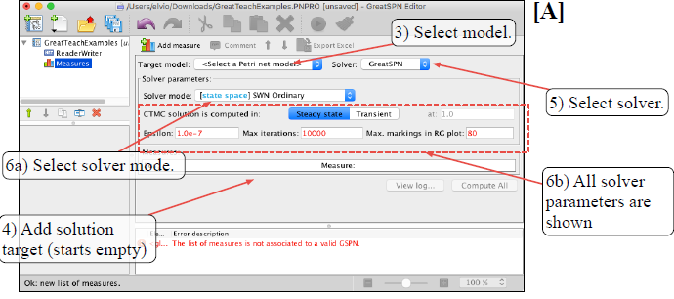
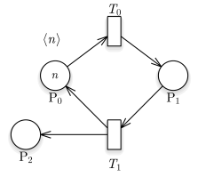
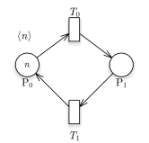
How to defeat students:
or like this:
make them do 8 steps ……
….. to visualize the state space
of a net like this:
or like this:

Slide 35
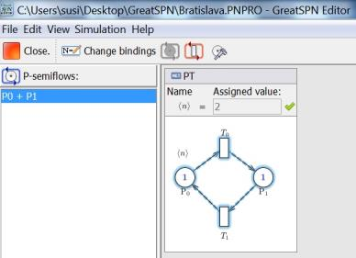
How to defeat students:
and for this???:
only a push buttom for
….. visualizing the P-semiflows
of a net like this:

Slide 36
Proposal
An enhanced and streamlined version of GreatSPN
Easy access to a subset of the available features
Example: the limited RG construction
Add visualization elements (RG, CTMC, and DD visualization)

Slide 37
Work done (1)
Change the interplay between nets, solvers and target measures
Three architectural levels:
A1. Only push buttom and see results (automatic kill and prefedined values) ==> dedicated icon in a ``Basic box menu’’
A2. Interactions in simplified form (pre-defined choices if necessary) ==> drop-down menu in an ``Advanced box menu’’
A3. Full set of commands and solvers ==> standard ``list of measures’’.

Slide 38
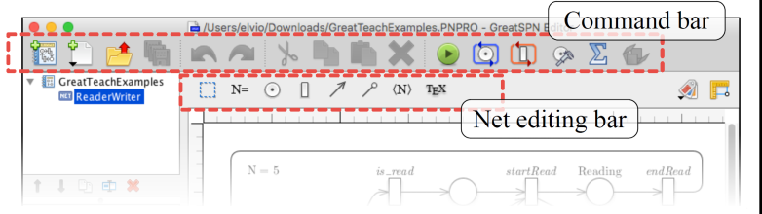
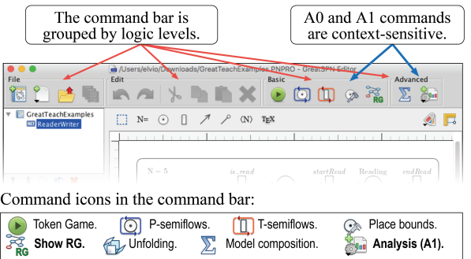
Work done (1ex)
Before
After

Slide 39
Work done (2)
Change the interplay between nets, solvers and target measures
Three learning objectives levels:
L1. Basic knowledge (be able to produce and analyze simple models in any net class)
L2. Intermediate knowledge (be able to use an extended set of analysis techniques)
L3. Advanced knowledge (be able to use and compare different techniques for the same target measures)

Slide 40
Work done (3)
For each net class (P/T, GSPN, WN, and SWN):
Identify the learning objectives
Classify them intro the three L_{i} levels
Associate to each learning level an architectural level
RULE:
for each objective at level L_{i} there should be at least one method at architectural level A_{i} or below

Slide 41
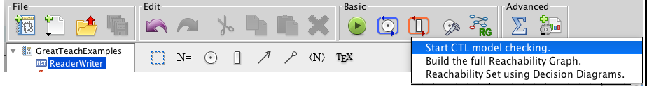
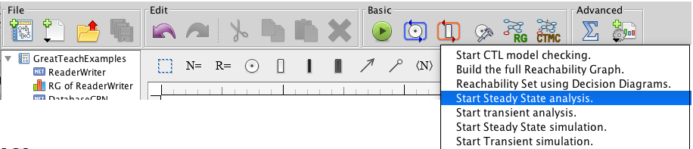
Work done (4)
Example for P/T
Example for GSPN

Slide 42
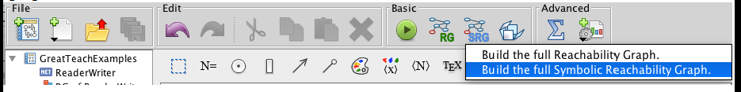
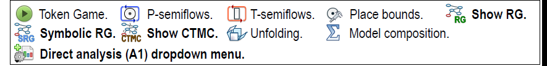
Work done (5)
Example for WN
New or re-implemented features in bold

Slide 43
Conclusions
GreatTeach architecture is inspired by very simple concepts
simple and/or basic concepts should have an easy access
the more the student learns about Petri nets, the deeper she/he can or should dive into the tool
Important to provide to students frozen (tested) versions
Different learning objectives require different choices for the Li levels: GreatSPN is now available on Github, and it is therefore easier to personalize it

Slide 44
Consequences (after having discussed the student’s’ projects)
A1. Only push buttom --- Most used
A2. Interactions in simplified --- Used if strictly necessary (explicit request in the project assignment)
A3. Full set of commands and solvers ==> standard ``list of measures’’. --- never used
Lesson learned:
….. if you do not see something you do not know it exists….

Slide 45
Planned improvements
new solver for P-flows and inequalities
make a number of analysis tools available again, or available at a lower architectural level (sensible choice)
find an easy way to make the stochastic logic CSL^{TA} easy to understand and its model-checker easy to use
move to containers for the solvers. Currently we use a virtual machine for distribution to non-linux environment (and linux as well!)

Slide 46
The Petri net tool GreatSPN and recent advancement in DD variable ordering
Elvio G. Amparore and Susanna Donatelli
Università degli Studi di Torino, Italy
merci de votre attention….

